Slide 1



The Impact of environmental factors on Food Prices and Production
IDSC Team

Slide 2
AGENDA SLIDE
01
Introduction
05
09
Policy
recommendations
Methodology
02
Adopted Use Case
06
Results and
Deliverables
10
Teamwork
03
07
Relevancy with the SDGs
07
Required Modifications
04
Dataset
08
Conclusion

Slide 3
Introduction: Global, Regional and Local Context
01
The world population is estimated to grow to reach 8.6 billion by 2030
Significant annual increase in world population
An annual increase of about 83 million people every year till 2030
Huge increase is needed for agriculture production
agriculture production should increase by 50 to 60% between 2030 and 2050.
A growing Expectations of the world population
Source: United Nations and FAO.

Slide 4
Introduction: Global, Regional and Local Context
01
Global farming productivity is 21% lower because of climate change, which has wiped out about 7 years of improvements in agricultural productivity over the past 60 years
Significant annual increase in world population
Global agricultural productivity is expected to decline by about 15% globally by 2050 as a result of rising temperatures and unstable weather.
A global action is required
To limit global warming to 1.5°C above pre- industrial levels, emissions must be cut by almost half by 2030.
Dramatic impact of climate change on agriculture sector
Source: United Nations, FAO, Stanford Wood Institute of Environment.

Slide 5
Introduction: Global, Regional and Local Context
01
Hosting COB27 and COB28 by Egypt in 2022 and the UAE in 2023
Increasing regional
food gap
Food Gap in the Arab region increased from USD 29 billion in 2010 to USD 44 billion in 2020 (with the group of cereals and flour constitutes around 48%)
A dramatic expected impact of climate change on Egypt agriculture sector
Agricultural production is estimated to decrease by 8 to 47% by 2060, with reductions in agriculture-related employment of up to 39%.
A regional special focus on fostering global climate change action
Source: Arab Monetary Fund and the UNDP.

Slide 6
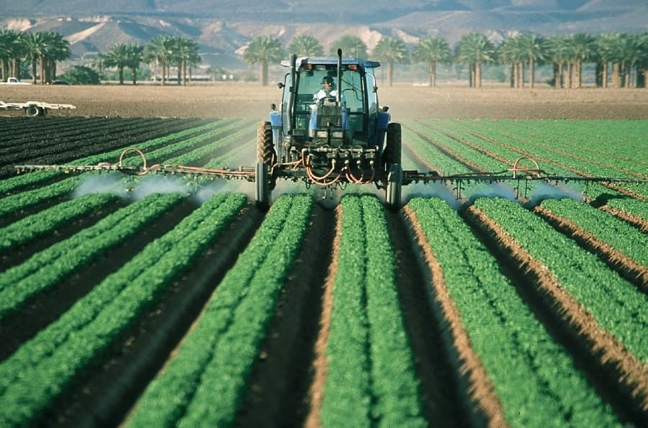
Adopted Use Case
02
Our project offers a comprehensive approach to predict global food production and prices by leveraging advanced data models.
We have developed two distinct models for food production prediction.

Slide 7
Adopted Use Case
02
The first model focuses on the impact of air emissions, providing insights into production values.
The second model takes a step further by incorporating both air emissions and temperature and land area as factors to enhance production predictions.
This dual-option framework equips us with a powerful tool to improve our understanding of food production dynamics.

Slide 8
Adopted Use Case
02
4. Once we have accurate production value predictions, we utilize this information to predict food prices, which is crucial for ensuring global food security and economic stability.
5. Our approach brings together environmental and climatic factors to enable more informed decision-making and policy recommendations in the agricultural and food industry, ultimately benefitting both producers and consumers worldwide.

Slide 9

Relevancy with the SDGs
03

Slide 10
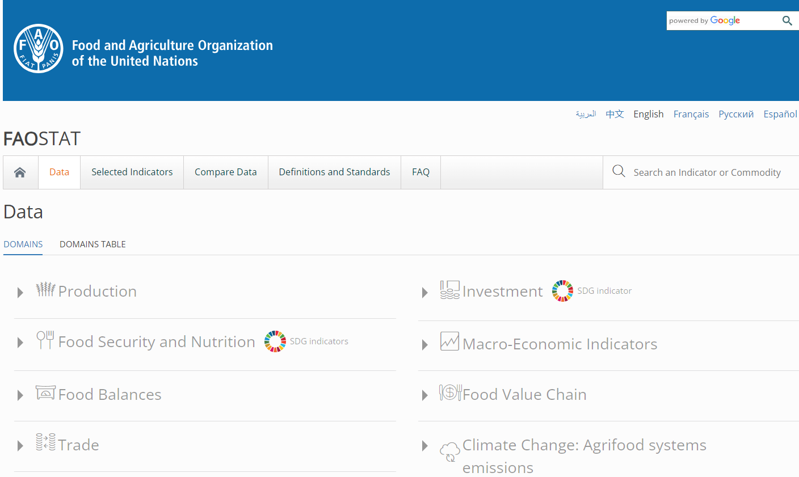

Datasets
04
Datasets are extracted from FAO
https://www.fao.org/faostat/en/#definitions

Slide 11
Datasets
04
Datasets are extracted from FAO
Air Emissions Data: https://www.fao.org/faostat/en/#data/GT
Crop Production Data: https://www.fao.org/faostat/en/#data/QCL
Food Price Data: Global Food Prices Database (WFP) - Humanitarian Data Exchange (humdata.org)
Temperature change on land: FAOSTAT
Land Use: FAOSTAT

Slide 12
Datasets
04
Integration of datasets for models
Integrated Emission data with Production data
Integrated Emission data, Temperature change on land, Land use and Production data
Integrated Food Price Data with Production data

Slide 13
Methodology
05
Our solution hinged on two key machine learning models:
XGBoost: The XGBoost model played a pivotal role in predicting production values based on air emission features
Long Short-Term Memory (LSTM) : We harnessed the power of Long Short-Term Memory (LSTM) for predicting production values affected by air emissions and forecast values for the next 5 years.
Linear regression model: Simultaneously, we employed a linear regression model to predict food prices from the production values.

Slide 14

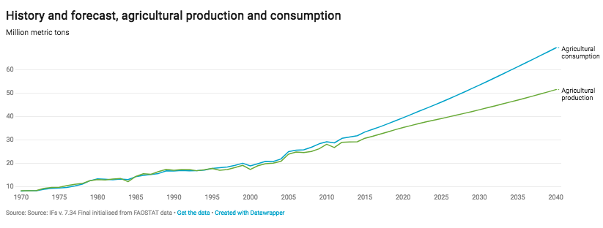
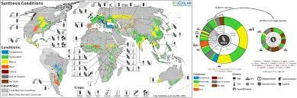



Results and Deliverables
06
Prediction
Powerpoint Presentation
Voice-over
Forecasting:
Geospatial illustration through maps and visualizations
Git Hub to place the code and the models to be licensed by MIT

Slide 15
Prediction
99.16%
XGBoost Accuracy

Slide 16
Xgboost features
07
Value: world wide agriculture production
Average Direct emissions (N2O)
Average Emissions (CH4)
Average Emissions (CO2)
Average Emissions (CO2eq) (AR5)
Average Emissions (CO2eq) from CH4 (AR5)
Average Emissions (CO2eq) from F-gases (AR5)Emissions (CO2eq) from N2O (AR5)
Average Emissions (N2O)
Average Indirect emissions (N2O)

Slide 17
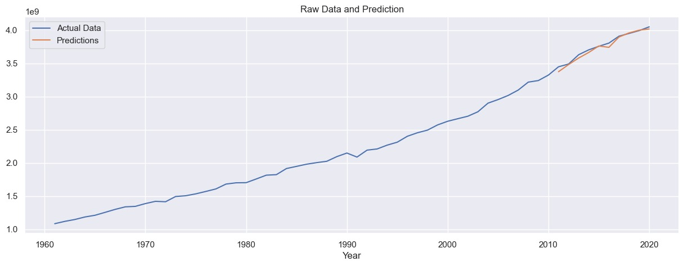
Prediction
XGBoost

Slide 18
Prediction
96%
LSTM Accuracy

Slide 19
LSTM features
07
average of emissions
average of land use
average of temperature change

Slide 20
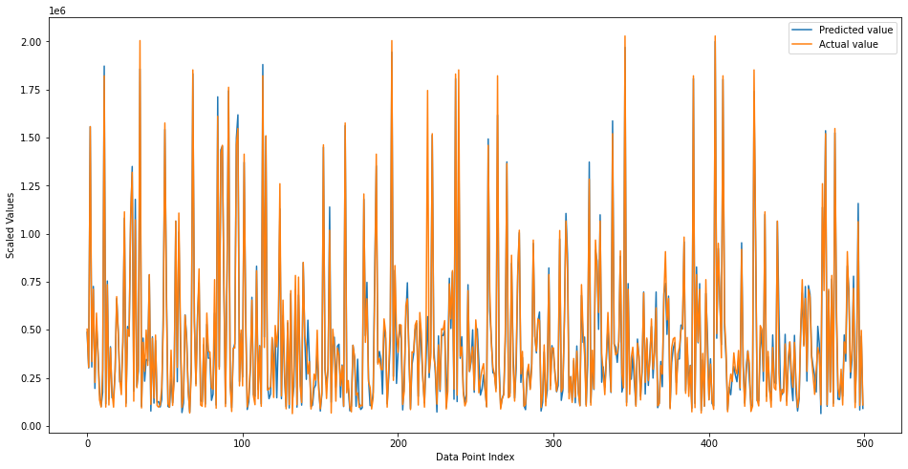
Prediction
LSTM

Slide 21
Prediction
0.74
Linear Regression
R-squared

Slide 22
Prediction
1.12
Linear Regression Mean Squared Error

Slide 23
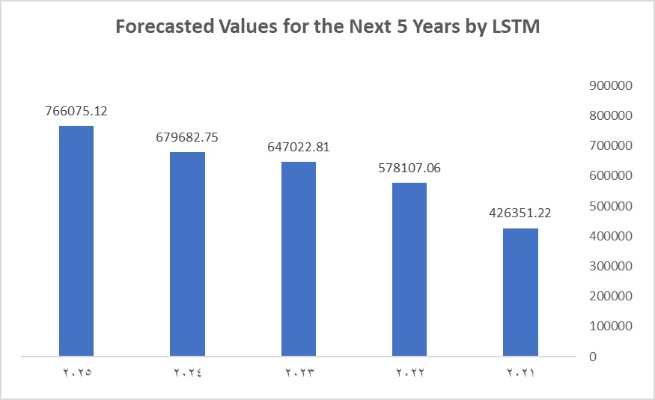
Forecasting

Slide 24
Visualizations for world food prices

Slide 25
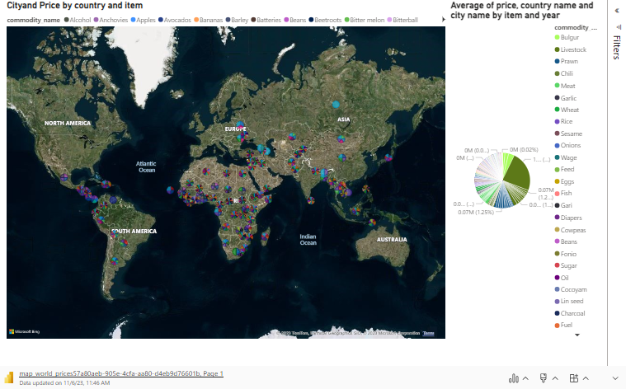

Slide 26
Visualizations for production

Slide 27
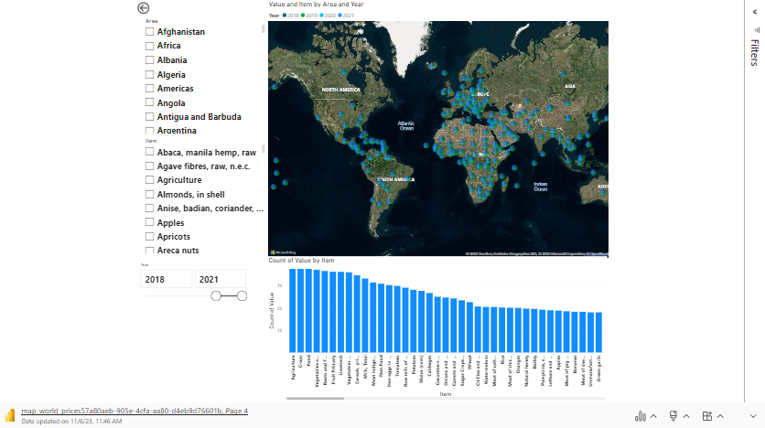

Slide 28
Visualizations for air emission

Slide 29
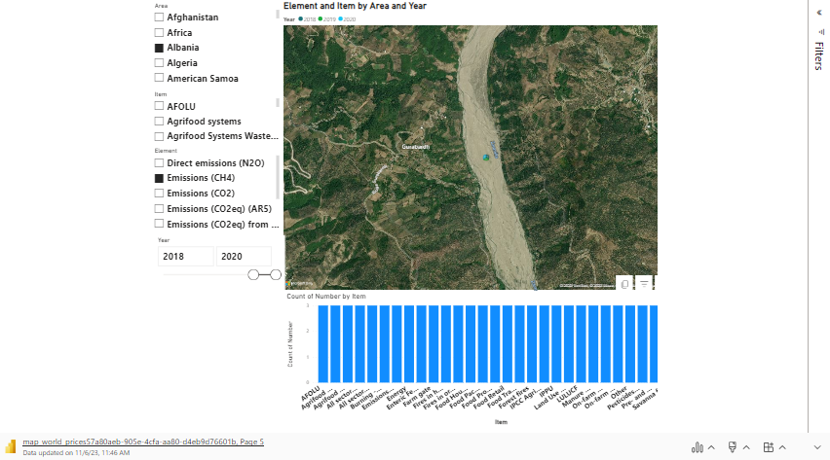

Slide 30
Visualizations for integration of production and air emission

Slide 31
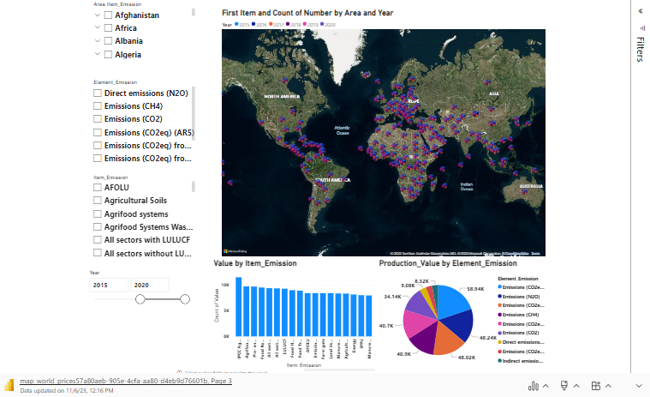

Slide 32
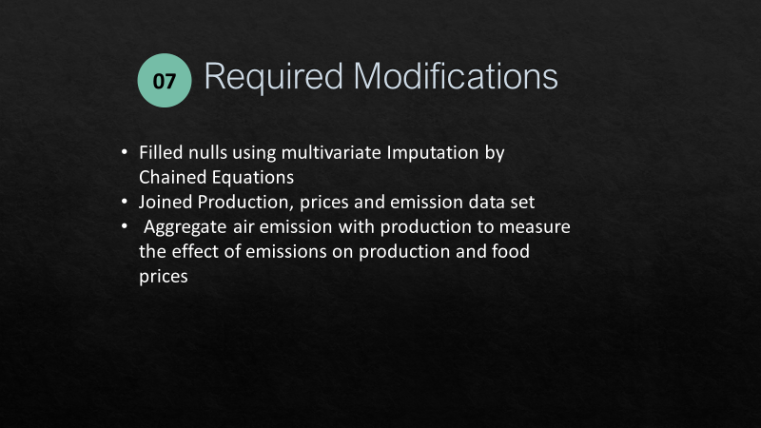

Slide 33
Conclusion
08
Our journey illustrates the transformative power of data and advanced machine learning models. By predicting food prices and production values with remarkable accuracy, we are contributing to a more secure, sustainable, and affordable global food supply chain. The impact of these insights ripples through the agriculture sector and beyond, inspiring positive change and a brighter future for all.

Slide 34
Policy Recommendation
09
Based on our findings, we offer several policy recommendations:
1. Economic Stability: Promote economic stability and mitigate currency exchange rate volatility to ensure food price predictability.
2. Climate-Resilient Farming: Encourage the adoption of climate-resilient farming practices and infrastructure to enhance food production in the face of changing weather patterns.

Slide 35
Policy Recommendation
09
The implementation of these recommendations can significantly impact key transitions:
1. Food Security: Enhanced food price predictability fosters food security, ensuring that essential commodities remain affordable.
2. Sustainable Agriculture: By promoting climate-resilient practices, our solution aids the transition towards sustainable agriculture, safeguarding the future of food production.

Slide 36
Policy Recommendation
09
The implementation of these recommendations can significantly impact key transitions:
1. Food Security: Enhanced food price predictability fosters food security, ensuring that essential commodities remain affordable.
2. Sustainable Agriculture: By promoting climate-resilient practices, our solution aids the transition towards sustainable agriculture, safeguarding the future of food production.

Slide 37
Team Members
10
Dr. Ali Wagdy
Dr. Ali Khater
Moaaz Youssef
Mohanad Atef
Nour Hany

